Slide 1


SOLAR BASED HOME AUTOMATION USING NODE MCU
Presented By:
Raghunath SP – 811720104079
Ragul R - 811720104080
Sunil D – 811720104107
Velukishore G - 811720104114
Guided By:
Mrs. V. Kalpana M.E.,(Ph.D).,

Slide 2
CONTENTS
Introduction
Objectives
Novelty Of Work
Identification Problem Statement
Power Supply Diagram
Block Diagram
Application
Implementation
Conclusion

Slide 3
INTRODUCTION
Wireless HAS using IoT is a system that uses mobile devices to control home functions automatically through internet.
It is meant to save the electric power and human energy
Solar power is becoming a sustainable source of energy.

Slide 4
OBJECTIVES
Reduce energy consumption.
Smart control system.
24/7 available.
Improve comfort.
Quick Response.

Slide 5
NOVELTY OF THE WORK
More energy can be conserved by ensuring occupation of the house before turning on devices.
The system can be integrated closely with the home security solutions enhancing the safety for home owners.
Customers will have the ability to buy and use the automation things themselves without the guide of any specific ace.

Slide 6
PROBLEM STATEMENT
Nowadays, People are improve their lifestyle using the latest technologies.
The more such facilities and appliances are added.
Living with disability and physically weak depend on others.
To improve their lifestyle and make their life inside home more easier,home automation gives a solution.

Slide 7
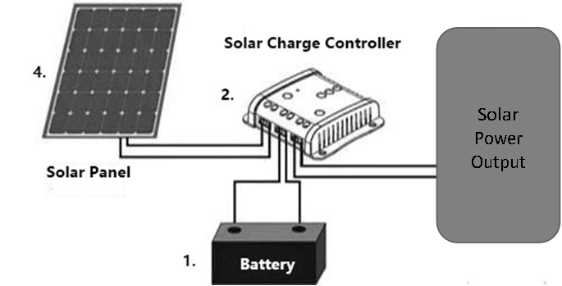
POWER SUPPLY DIAGRAM

Slide 8
BLOCK DIAGRAM
BLYNK App
Mobile
Light
WIFI MODULE
NodeMCU
Digital output
12V solar power output
Inverter
220 V
4 channel relay
Fan
Water pump
Lamp

Slide 9
BLOCK DIAGRAM DESCRIPTION
The home get its power from the solar panel.
Battery is used to store the energy for 24/7 accessibility.
Solar charge controller is used to keep the battery from overcharging.
A 5V,4 channel relay acts as a switch that controls the home appliances.
NodeMCU is a micro-controller unit which can connect object and let data transfer using wifi module.

Slide 10
OUTPUT
These are the output Generated from the given input by the user.
Home appliance A - Light
Home appliance B - Fan
Home appliance C - Water Pump
Home appliance D - AC

Slide 11
APPLICATION
Lighting control system.
Heating , ventilation and air conditioning(HVAC).
Occupancy-aware control system.
Appliance control and integration.
Home robots and security.
Home automation for the elderly and disabled.
Smart Kitchen and Connected Cooking.

Slide 12
COMPONENTS REQUIRED
NODEMCU-ESP8266
USB Cable
Connecting Wires
Android Phone with Blynk App
Inverter
Relay Driver
Solar panel
Battery
Light

Slide 13
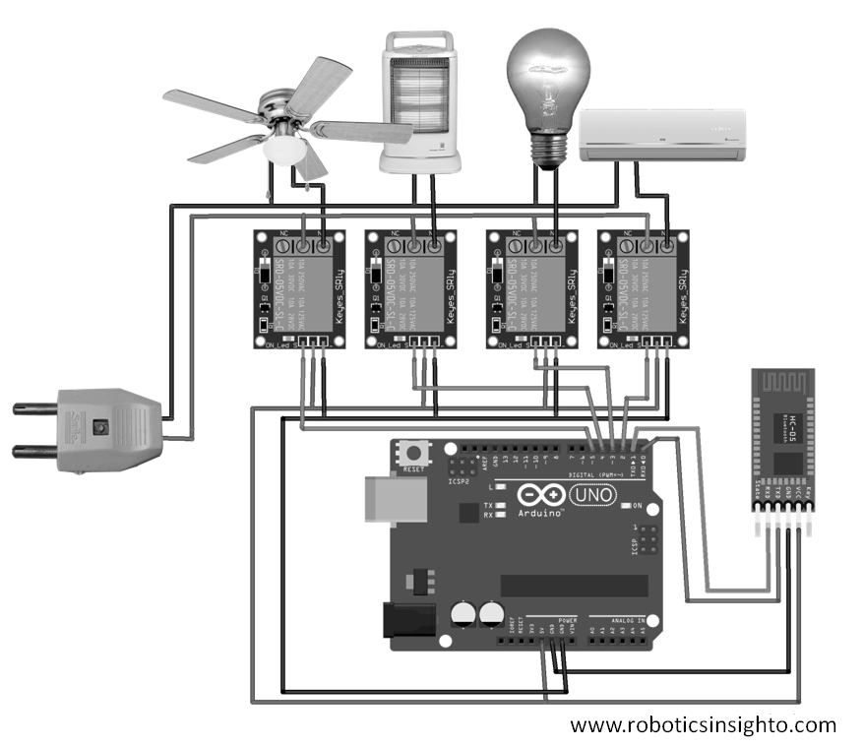
IMPLEMENTATION

Slide 14
IMPLEMENTATION OF BLYNK APP
Step 1: Create Blynk Cloud FREE Account
Step 2: Create a New Template in Blynk Cloud
Step 3: Create a Data stream in Blynk Cloud
Step 4: Set Up Blynk Cloud Web Dashboard

Slide 15
BLYNK APP…
Step 5: Add Widgets in Blynk IoT App
Step 6: Program the NodeMCU for This Blynk Project
Step 7: Update the Wi-Fi Credentials Through OTA
Step 8: Connect the Home Appliances
Step 9: Finally!! the Blynk Smart Home System Is Ready

Slide 16
EQUIPMENT’S SPECIFICATION
BATTERY:
Voltage - 12V
Capacity - 7Ah
Dimension - 151*65*100 mm (L*W*H)
Maximum charging current - 45A
Weight – 2.20 kg
RELAY :
Channels - 4
Size - 75mm*55mm*19.3mm(L*B*H)
Weight – 58 gm
Maximum output – 30V/10A (DC)
250V/10A(AC)

Slide 17
SPECIFICATION…
BULB:
Power – 15W
SOLAR PANEL:
Maximum power - 20W
Open circuit voltage - 21.6 V
Short circuit current - 0.65A
Maximum power voltage - 19.6 V
Maximum power current – 0.59 A
SOLAR CHARGE CONTROLLER:
Maximum output current – 10A(DC)
6A(DC)
Battery charging voltage – 14.4 – VDC
Vmax in on battery terminals - 25 – VDC

Slide 18
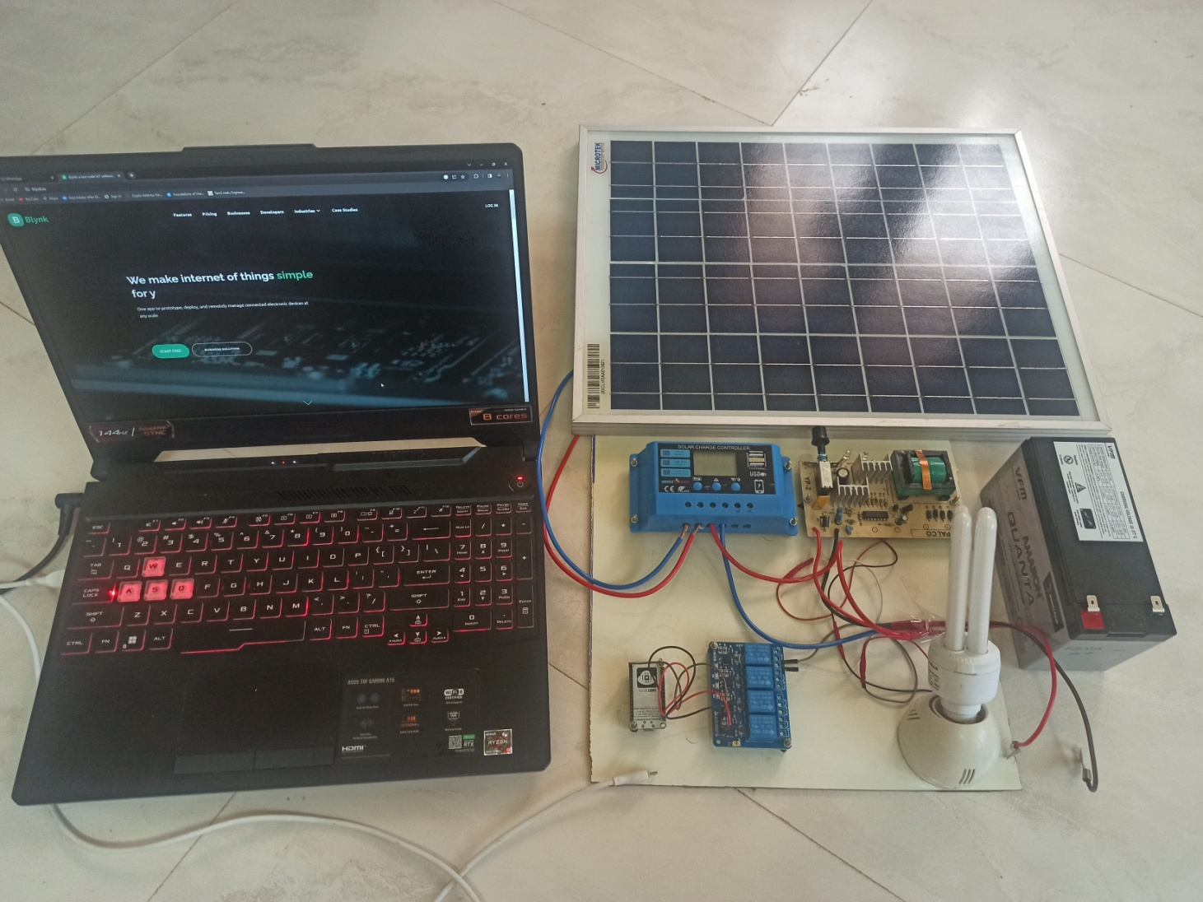
RESULT

Slide 19
CONCLUSION
Home automation is a resource which can make home environment Automated.
People can control their electrical devices via. Smartphone These home automation devices and set-up controlling action through mobile.

Slide 20
REFERENCES
Vikram.N, Harish.k, Nihaal.M, Raksha umesh ,Shetty Aashik Ashok kumar, “A Low Cost Home Automation System Using Wi-Fi Based.
Ravi Kishore Kodali, Vishal Jain, Suvadeep Bose and Lakshmi Boppana. “IoT Based Smart Security and Home Automation System”, pp. 1286-1289, 2016.

Slide 21
THANK YOU

